Slide 1
Questions
What is CASA framework
How CASA framework work
Configuration of CASA
How it works – Pages
How it works - the plan
How UI is designed internally
How UI interact with Backend service
One end to end flow
How session data maintained

Slide 2


Slide 3
CASA (Capture And Submit Application)
CASA is a framework to simplify the configuration of an Express Node application where the application requires the user to enter information on a series of pages (a ‘journey’) in a particular order.
As such it enforces:
The ordering of the pages
The validation of the input
and provides additional capabilities such as contextual session storage to aid maintenance of state between page visits, access to il8n routines, access to Nunjucks components

Slide 4
Express Application
CASA Middleware
(Provide Get and Post middleware for each page)

Slide 5

How CASA framework works
Configuration of CASA
Explain each component
How it works – Pages
How it works - the plan

Slide 6
Configuration of CASA Framework
CASA is configured by passing in an object which specifies
A series of waypoints (an array of Page types)
A Plan, which specifies the order in which the Pages must be visited
The session configuration
The location of any views
The location of any il8n files
Any plugins required
Any hooks required
The base URL at which the application will be mounted

Slide 7
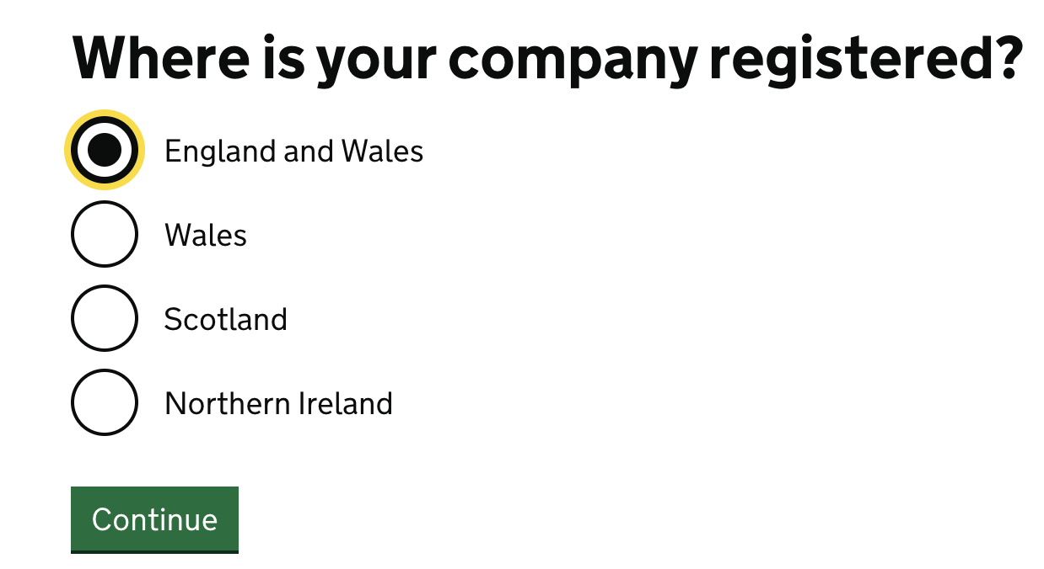
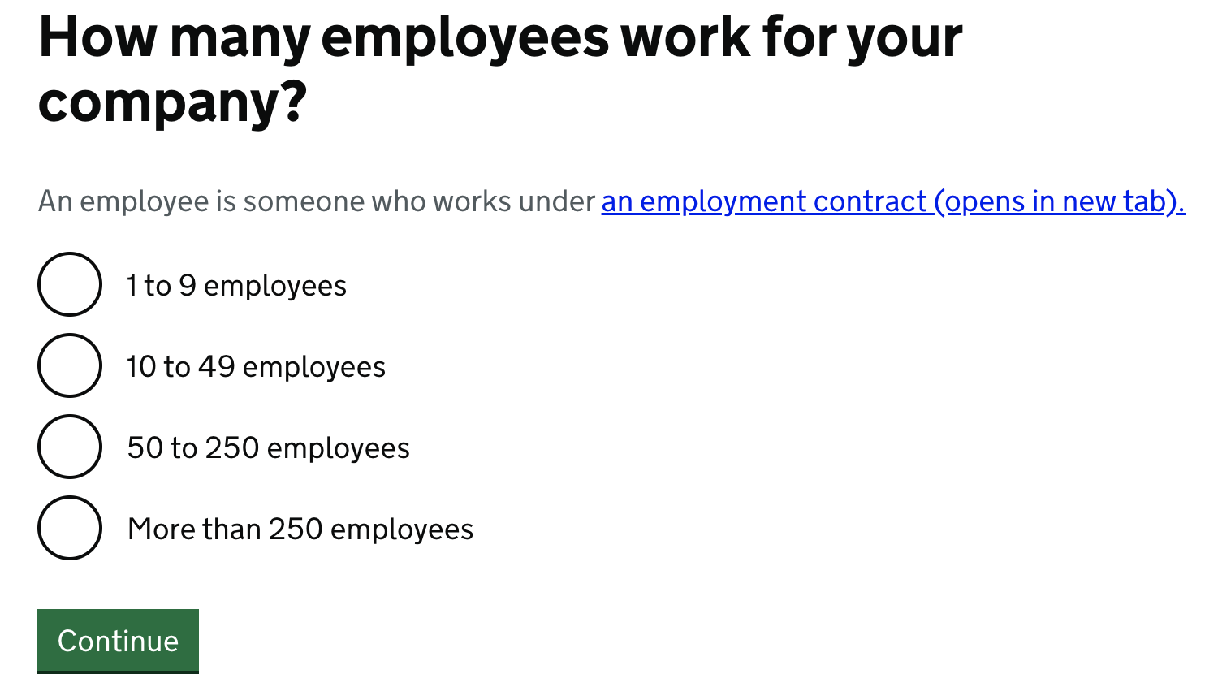

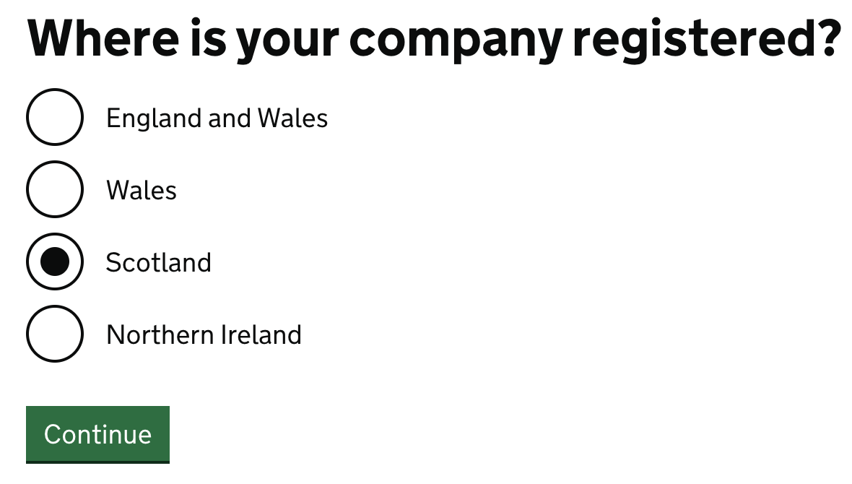
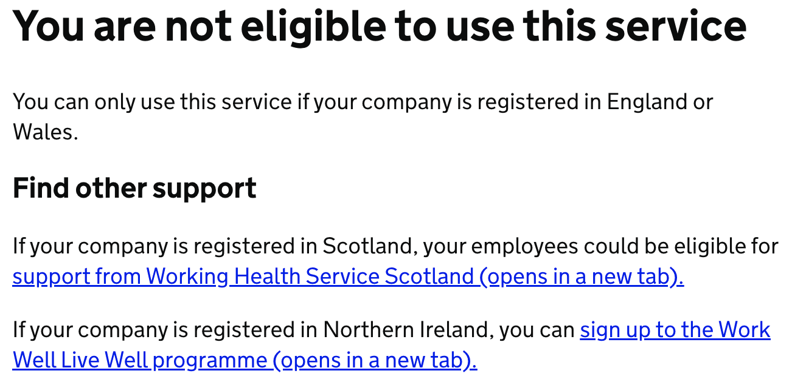
Start now

Slide 8
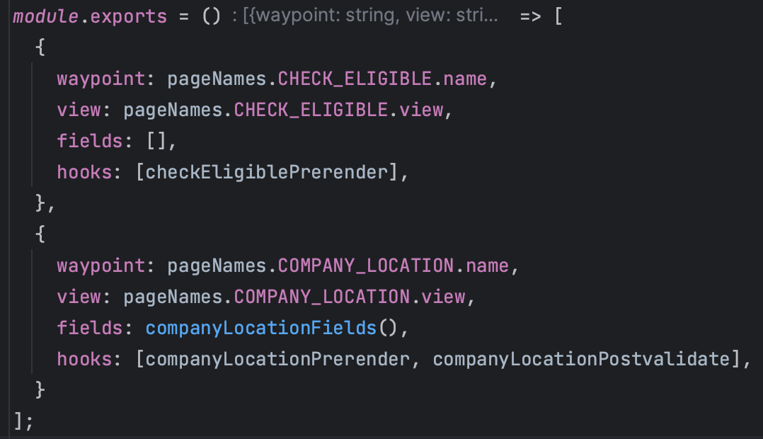
Casa Page and its structure
The Pages for a journey are specified by providing CASA with an array of Page objects
{ waypoint: string; // the name of the waypoint view: string; // the location of the view which is relative to the base view locations configured fields: Field[] //an array of functions to validated fields on the page on submission hooks: PageHook[] // an array of functions that specify hooks to be run during rendering or submission }
Example:

Slide 9
How the Plan works
The CASA Plan is an instance of the Plan class, which specifies the order in which the pages are displayed to the user, together with any conditional routing.
Using conditional routing, we can specify that – subject to the given conditions particular pages are displayed when the conditions are met.
A Plan must have at least two waypoints.
A Plan must have an entry point (start waypoint) and, following the posting of the final waypoint

Slide 10
How session data maintained
CASA enforces and facilitates session storage by mandating the inclusion of a session storage mechanism as part of the configuration.
During the journey, CASA maintains a journeyContext object in the session, which contains:
The validation state of each page
The values submitted by the user on each page (an array of objects keyed by the waypoint name)

Slide 11

Application flow

Slide 12


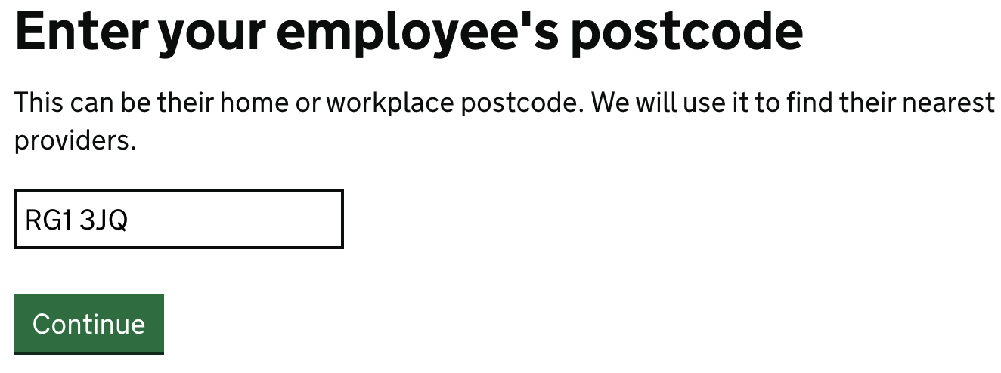
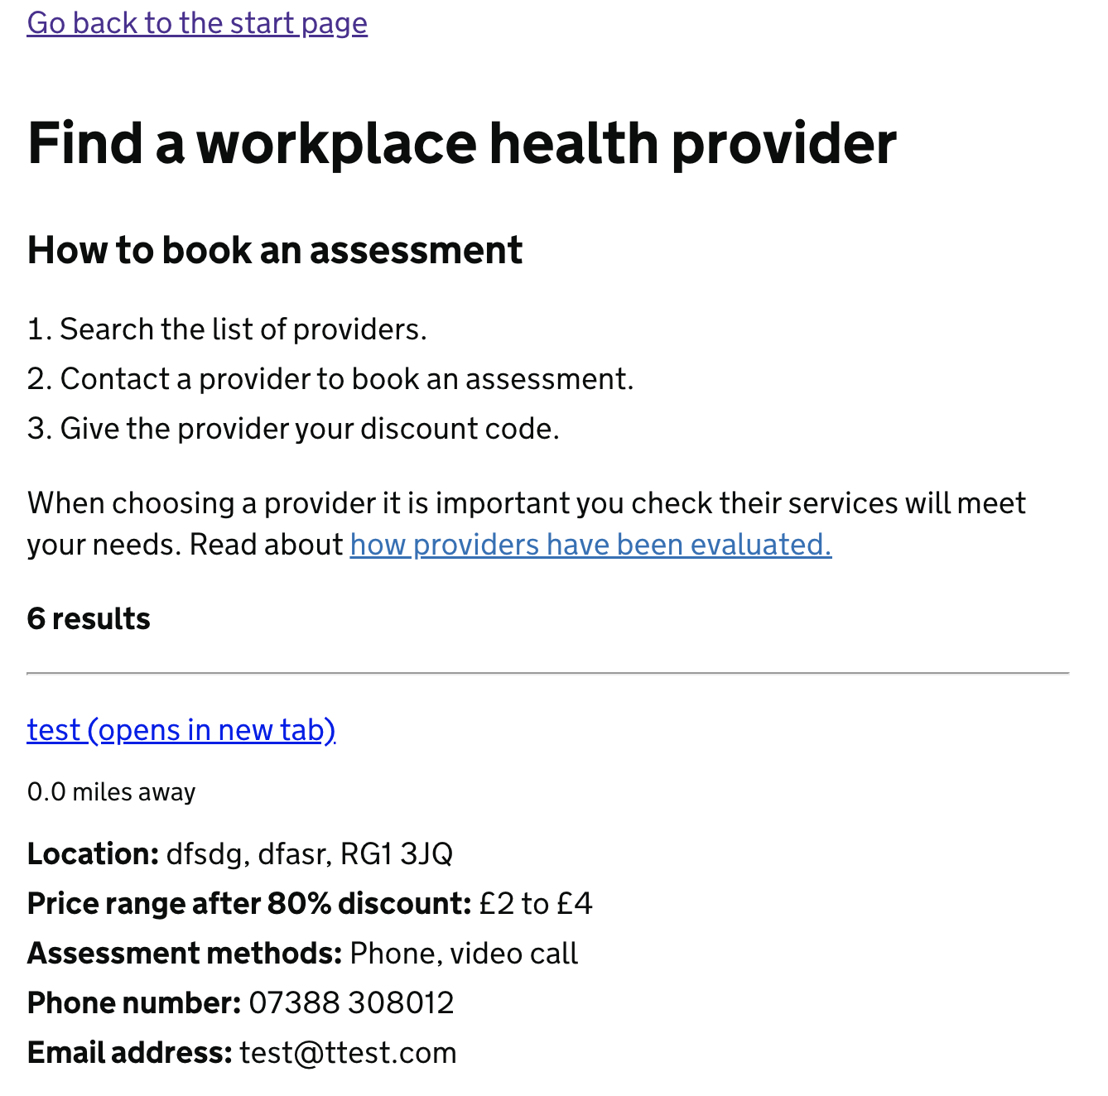

Express Application Server
Spring boot Service
User entered URL
http://localhost:3003/employer-eligibility/employee-workplace-health-assessment-discount
- Decide routing
- Execute middleware
- Error handling
- view rendering etc.
HTML code returned
http://api.getthedata.com/postcode/RG13JQ
/validate-postCode
Calling external API
http://localhost:3003/search-provider
- Decide routing
- Execute middleware
- Error handling
- view rendering etc.
http://localhost:9501
/providers/clinics-by-proximity?postcode=RG1 3JQ
JSON Response
HTML code returned

Slide 13

Thank you

